Slide 1


La industria del papel y celulosa latinoamericana: entorno empresarial
Marina Faleiros, Senior News Editor
Mayo 2015
mfaleiros@risi.com

Slide 2
Resumen del CV
Gerencia informaciones del sector de celulosa, papeles gráficos y cartón en América Latina para la consultoría americana RISI, la mayor proveedora de informaciones para la industria de base forestal en el mundo.
Ubicada en la oficina de San Pablo, trabaja con reportes y análisis sobre la macroeconomía de la región y los principales movimientos de la industria de celulosa y papel.
Ya visitó profesionalmente todos los principales complexos industriales del sector en los países del continente y anteriormente trabajó en la Asociación Brasileña Técnica de Celulose y Papel (ABTCP).
Graduada en periodismo por la universidad Cásper Líbero y actualmente cursa MBA en Finanzas y Economía
Ya reportó sobre la economía brasileña en dos de los mayores periódicos del Brasil, O Estado de S. Paulo y Folha de S. Paulo.

Slide 3
Notes and Abbreviations
Dollar figures are per tonne unless noted
BSK = Bleached Softwood Kraft Pulp (“long” fiber)
  NBSK (northern), SBSK (southern), radiata
BHK = Bleached Hardwood Kraft Pulp (“short” fiber)
  BEK (eucalyptus), NBHK (northern mixed, maple, aspen), acacia, mixed tropical hardwoods
DP = Dissolving Pulp, primarily textile grade (viscose)
P&W = Printing & Writing Paper
  Coated and uncoated; woodfree and mechanical
AVC = Average Variable Cost of Production
  Also called Delivered Cash Cost—no depreciation, interest, corporate overhead or selling costs
TPY = Tonnes per Year

Slide 4
Celulosa mundial: desarrollos recientes

Slide 5
Highlights of 2014 Capacity Developments
BHK Developments
  Montes del Plata startup
    1.3 million TPY, Jul 2014
  Oji Nantong startup
    ~500,000 TPY, Jul 2014
  Old Town closure
    ~200,000 TPY, Aug 2014
  ENCE Huelva closure
    ~400,000 TPY, Aug 2014
BSK Developments
  Ilim Bratsk
    Finised a long ramp-up after a maintenance shut in June
  Pols (Austria)
    Recovery boiler repair
    ~200,000 TPY loss until late 2015

Slide 6
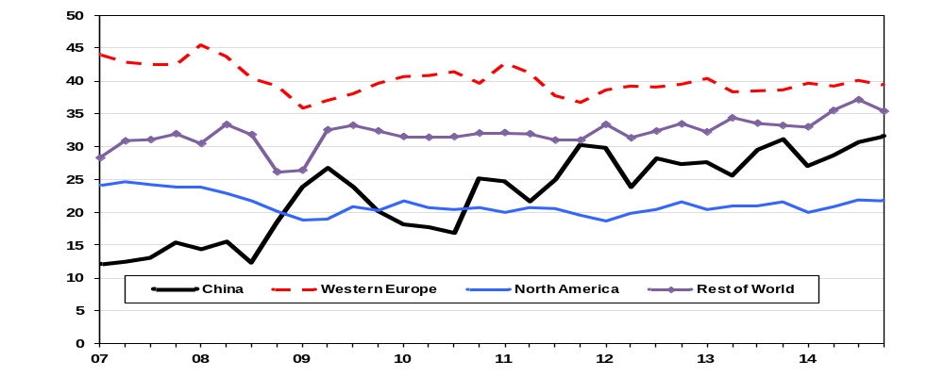
As Expected, Pulp Demand Was Stronger in Second Half 2014, Especially in Asia
World-20 Shipments by Destination, Thousand Tonnes per Day

Slide 7
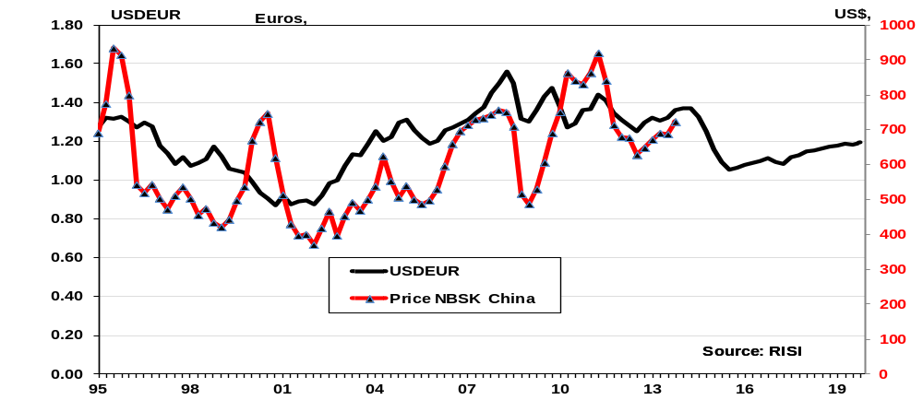
A Strong US Dollar Tends to Hold Down Commodity Prices, Including Pulp

Slide 8
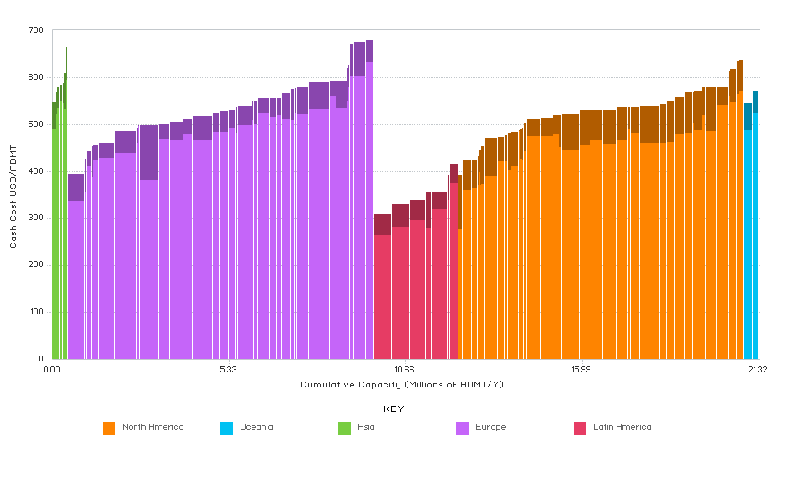
BSK Delivered Cash Costs to Shanghai: Third Quarter 2014
RISI Cost Benchmarking

Slide 9
World Production of Paper and Board
Graphic, Packaging and Specialty and Tissue; Percent Change

Slide 10
The New Reality for World P&W Demand:
Peak Demand Has Already Happened

Slide 11
Demand for Tissue Papers
Million Tonnes

Slide 12
Pulp Supply and Risks
Large BHK capacity expansions around mid-2015
  CMPC Guaiba: 1.3 million tpy, mid-2015. Risks?
Continuing swing from BHK to BSK production
  Certainly as long as price gap is >$100/tonne
Continuing shift from “integrated” to “market” pulp in North America and Europe
  Cost curve is shifting downward…could accelerate if the US “super dollar” reappears
    A reprieve for small, inefficient BHK lines in Europe?
DP demand still growing briskly, pulling some paper grade pulp capacity into DP production

Slide 13
Key Points for the 2015 Forecast
Pulp demand outside of China is growing slowly, so Chinese inventory swings dominate the demand side
  There will be a large increase in Chinese BHK import demand in 2015
A stronger economic environment in 2015 worldwide will boost pulp demand, but not by as much as was expected
The next BHK line to start up will be in mid-2015, helping to pull the industry operating rate (and profitability) down in the middle of the year
Euro risk is still substantial

Slide 14
Papeles para empaque

Slide 15
Is Global Containerboard Still Growing?

Slide 16
Emerging Markets Are Growing Faster
16

Slide 17
But Even They Are Slowing Down

Slide 18
The Latin American Markets are Among the Fastest Growing Markets in the World
Percent Increase in Demand, 2009-2012

Slide 19
The Growth Markets Can All Be Expected to See Demand Rise with Standard of Living
2012 Figures

Slide 20
The Latin American Packaging Markets Are Far from Homogenous

Slide 21
The 10 Largest Latin American Paper Packaging Markets by Tonnage

Slide 22
Brazil Has the Largest Economy in Latin America, and Also the Largest Packaging Market

Slide 23
Brazil Stands Out from the Rest of Latin America on the Trade Front
Net Imports, Thousand Tonnes
Notes:
Especialidades – como kraft para produccion de laminados, algunos tipos de cartocillos solidos blancos,

Slide 24
The Mexican Packaging Markets Are More Volatile than the Brazilian Market Due to the Influence of the USA

Slide 25
Argentina Is One of the Few Countries in Latin America Where Demand Lags Well
Behind GDP Growth

Slide 26
Chile Has Turned in Fairly Steady Growth in Paper Packaging Demand

Slide 27
Chile Has Been the Only Country Other Than Brazil to Maintain a Trade Surplus
Net Imports, Thousand Tonnes

Slide 28
Conclusions: The Latin American Packaging Markets …
May be small in absolute terms on the global scale
  But contribute significantly to global growth given the high growth potential for the region
Are quite diverse, reflecting each country’s economic makeup
  The markets in any individual country may struggle during a particular year
  But growth in other parts of the region often offsets this
  Resulting in more even growth than is seen in other parts of the world
Are a critically important
  For participants located within the markets
  As well as those from outside Latin America

Slide 29
Cartón

Slide 30
How Are the Global Markets Coping with China’s Capacity Bulge?
* Realized Capacity Growth 2009-2013, Planned 2014-2015

Slide 31
Boxboard Demand in the Rest of the World Is Small (5.3 Million Tonnes in 2013) But Growing Rapidly
Million Tonnes and Percent of Global Demand

Slide 32
Brazilian Exports of Multi-ply Boxboard Compete in Global Markets with the Other Coated Virgin Grades
Thousand Tonnes

Slide 33
Latin American Demand to Outpace Capacity Expansion, Leading to Modest Growth in Net Imports for the Region
33
Notes:
33

Slide 34
Latin America, Africa and the Middle East Will Be the Battle Grounds for Virgin Boxboard Exports
Net Imports, Thousand Tonnes

Slide 35
Take Home Points for Global Boxboard
Demand should continue to grow across the world in 2015-2016
The massive capacity build in China will have an impact on global trade throughout this period
  Especially in the solid bleached and multi-ply virgin sectors
    Current suppliers to the Asian market will be displaced and will be seeking new homes for their exports
    Chinese ivoryboard mills will have costs similar to European mills, and will be competitive in areas where shipping costs are nearly equal
    Latin American and North American mills still have cost advantages over Asian producers, but prices in these regions are above the cost floor

Slide 36
Papeles para impresión

Slide 37
World Printing & Writing Paper Demand
Is the global market in decline? Yes, its just a matter of degree.
Million Tonnes

Slide 38
Yet, Global UFS May Still Be Growing… Mechanical grades appear to be flat or declining globally
Global Demand, Million Tonnes

Slide 39
Global UFS Demand Growth for 2015 and 2016 Varies by Region
Thousand Tonnes, Percent per Year
-42 (-0.7%)
-478 (-2.9%)
-140 (-1.0%)
576 (1.0%)
76 (2.9%)
102 (1.4%)
138 (4.3%)
-21 (-2.3%)
Global: 211 (0.2%)

Slide 40
Latin America: Small, Yes… But Growing Market??
UFS largest and growing
  Graphic demand fell 4% in 2013 and 1-2% in 2014
  Optimistically expecting this to turn slightly positive in 2015-2016
  Newsprint only grade in decline
* Annual growth rate 2015-2016

Slide 41
…The Region’s Imports Are Growing While Producers Focus on Pulp
EBITDA margins are far better in pulp as it leverages the low wood costs better than paper
Newsprint requires softwood or recycled fiber, neither of which is plentiful in Latin America, so it is often imported
Uncoated freesheet exports from Brazil offset by imports elsewhere
All other grades require imports from abroad to fulfill market requirements…CFS imports have inundated certain markets
Operating rates are only 88-90% due in part to imports

Slide 42
Mexico…Better Prospects than Most of Latin America Due to Stronger GDP and Link to US Markets
Mexico GDP back to 3% in 2015-2016
Newsprint will not recover but could stagnate ... an improvement from past trends
Uncoated freesheet struggling with slight declines in 2013-2014
RISI Forecast of Renewed Growth in Demand Seems Optimistic and Based on Stronger GDP
* Annual growth rate 2015-2016

Slide 43
Comparative Costs for Producing Standard 20 lb/75 gsm Cut Size Office Papers
US Dollars per Tonne, Second Half of 2013

Slide 44
World Uncoated Freesheet Demand
Million Tonnes, Percent Change
2011 2012 2013 2014 2015 2016
North America 9.3 8.8 8.8 8.4 8.1 7.9
%ch -4% -5% 0% -5% -3% -3%
Western Europe 7.6 7.4 7.0 7.0 7.0 6.9
%ch -5% -3% -5% 0% -1% -1%
Eastern Europe 3.0 3.1 3.1 3.1 3.1 3.1
%ch -3% 2% 1% 1% -2% 0%
Far East 26.9 27.3 27.7 27.8 28.0 28.3
%ch 4% 2% 2% 0% 1% 1%
Latin America 3.6 3.6 3.6 3.7 3.7 3.8
%ch 1% 0% 0% 2% 1% 1%
Middle East, Africa, Oceania 3.2 3.4 3.2 3.3 3.4 3.5
%ch 5% 6% -4% 3% 3% 3%
  Total 53.7 53.6 53.5 53.3 53.4 53.5
  %ch 1% 0% 0% 0% 0% 0%

Slide 45
Global Demand for Cut Size Uncoated Freesheet Paper
Thousand Tonnes
.

Slide 46
North American Demand for Cut Size Uncoated Freesheet Paper (Thousand tonnes)

Slide 47
Latin American Demand for Cut Size Uncoated Freesheet Paper (Thousand Tonnes)

Slide 48
Per Capita Consumption of Cut Size Uncoated Freesheet Paper by Region
KG/Person

Slide 49
Global Overcapacity Developed in
2011-2013
Announced Net Uncoated Woodfree Capacity Changes for 2011-2013 vs. Demand Growth for the Same Period, Thousand Tonnes
Note: Asian capacity expansions exclude the offsetting effect of government mandated closures of small, old, polluting mills

Slide 50
Leading to a Rise in Exports from Asia While Brazil’s Net Exports of Uncoated Freesheet Stagnate

Slide 51
UFS Demand and Capacity Changes More Balanced for 2015-2016
Announced Net Uncoated Woodfree Capacity Changes for 2015-2016 vs. RISI Forecast of Demand Growth for the Same Period,
Thousand Tonnes
Note: includes prorated capacity changes for 2014

Slide 52
Uncoated Woodfree Operating Rates
North American shuts had surprisingly little impact on operating rates due to surge in imports

Slide 53


















Paper & Board Markets – Global
Improvements in developed economies, led by robust growth in the USA and the end of recession in Western Europe, will drive improved paper and paperboard demand growth over the next two years.
This improvement comes even as the Chinese economy slows and Brazil officially enters recession, but the growth of the US economy seems to be domestically fueled.
A major round of capacity expansion in Asia will put pressure on global tissue and boxboard markets despite projected healthy demand growth.
Despite major capacity closures by North American producers in 2014, global graphic paper markets remain oversupplied, with stagnant global P&W demand and a negative outlook for newsprint.
Paper and Board Demand
Newsprint
Tissue
Printing & Writing
Cartonboard/Other
Containerboard
Figures outside of pie chart are forecast changes
in demand from 2014 to 2016.
Notes:
Not done

Slide 54
Muchas gracias!
mfaleiros@risi.com

Slide 55
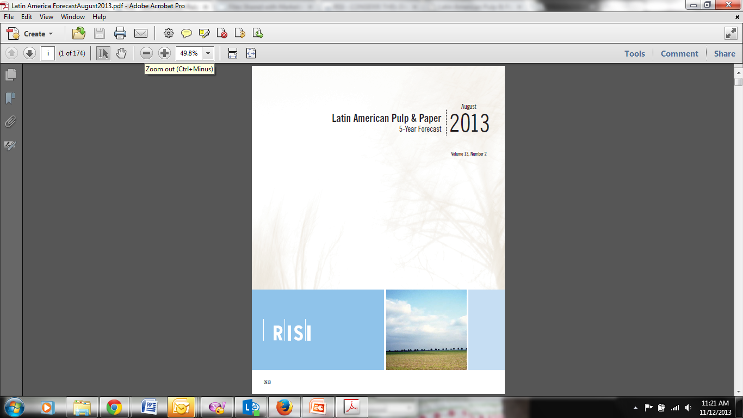
Thank you for your attention!
For more information:
Latin American Forecast
www.risi.com/latinam

