Slide 1

Providing Value with Nalco’s FLOCMASTER Technology
Kleber Martins
April, 2015

Slide 2
Agenda
Understanding Customer’s Challenges
Understanding Our Solutions
Partnering to discover Value
Notes:
The objective of the presentation is to show you that we, Nalco, continuously seek to deeply understand the challenges that you face in your wastewater plant; With your challenges in mind, we design market offerings that can specifically meet your needs. We aim to establish and develop a link much deeper than a just simple customer-supplier relationship, we are looking for long-term partnerships.

Slide 3
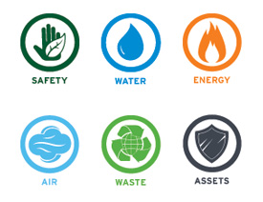
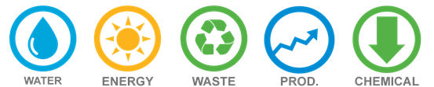
Understanding Customer’s Corporate Challenges
Companies cannot afford:
Not meeting their sustainability goals
Not meeting conditions in discharge permit
Inadequate water and energy efficiency
Lost production capacity and outages
Poor control and high maintenance costs
Sustainable Operation
Total Cost of Operation
Companies would like to:
Improve System Performance & Operational Stability and efficiency
Reduce waste disposal , chemical and equipment cost
PRODUCTIVITY
Notes:
In today’s challenging business environment, companies are continuously striving to enhance safety, reliability, profitability and efficiency, while trying to improve overall sustainability performance, including environmental compliance.
At Nalco we are continuously striving to develop innovations that meet current and future sustainability needs of the industry.

Slide 4
Understanding Customer’s Wastewater Challenges
Common issues in sludge dewatering operation
Companies cannot afford:
Companies would like to
Low solids content of sludge creating cost to increase
Poor solids capture in dewatering creating operational issues
Production limitations due to inadequate capacity of sludge handling
Variable sludge volume and solids content due to fluctuations in incoming wastewater
Not meeting their sustainability goals
Not meeting conditions in discharge permit
Inadequate water and energy efficiency
Lose production capacity and outages
Poor control and high maintenance costs
Higher sludge haulage and processing cost
Better manage or reduce water consumption
Improve cake dry solids
Reduce sludge volume
Improve hydraulic load of dewatering equipment
Reduce maintenance cost
Dose chemical products on demand rather than on sludge volume

Slide 5
How Nalco’s Solutions Help Meet Your Challenges
CONSUMABLES
Antiscalants, Antifoam,
Water Treatment
SERVICES
Value-Added
Consulting,
Engineering,
Technical Support
What Nalco Provides
Innovative
Solutions
EQUIPMENT
Feed, Storage & Analysis, Control
and Water Treatment
Enhanced
Competitive
Advantage
Asset Reliability
Increased
ROI
Decreased
Total Cost
Of Operation
What Customers Receive
Minimized
Environmental
Health & Safety
Concerns
Improved
Operating and
Production Efficiencies
Notes:
Our approach to the market is that we will provide you with integrated innovative solutions, that can consist of chemicals, equipment, automation and services. The innovative solutions are only important to you when they generate a return on your investment, what could be in improving your TCO, addressing your sustainability goals, securing your asset reliability and/or improving your production efficiency and competitive advantage.
We would like to bring to your attention an integrated solution in the area of antiscalant dosage, control and optimisation.

Slide 6
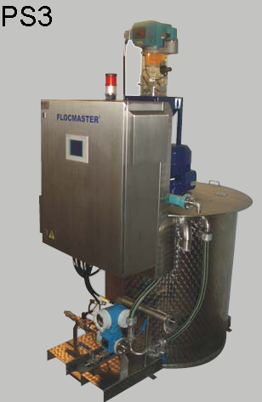
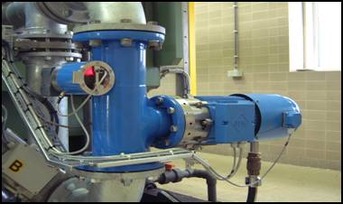
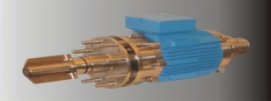
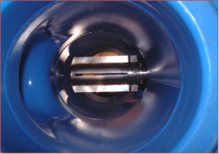
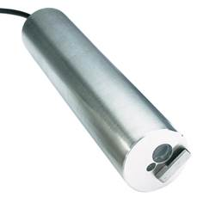
Understanding Our Solutions
High efficiency polymer preparation stations that allow 50-80% water savings when compared to conventional units.
Coagulants
Flocculants
FLOCMASTER Technology
Services
Patented dynamic system for advanced mixing of polymer in all types of industrial sludges. The result is optimum dosing, improved dewatering and higher dry cake solids.
On-line control responds to continuous changes in flow or concentration of sludge

Slide 7
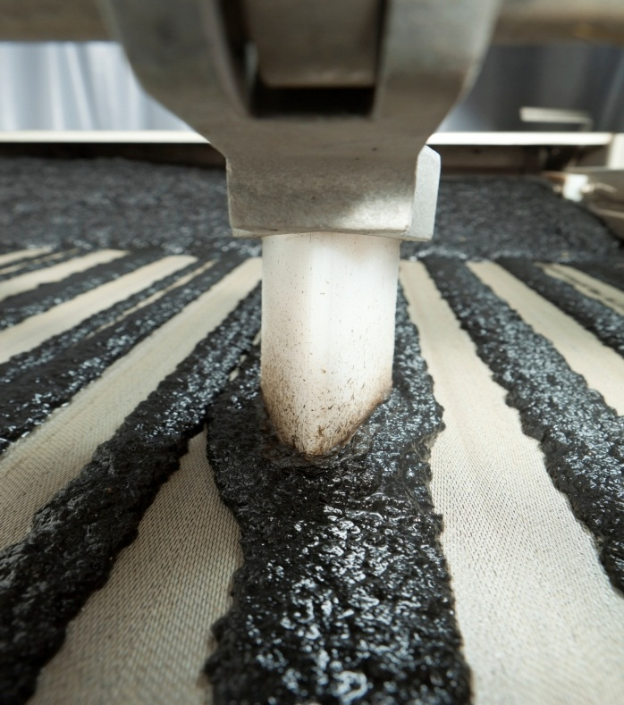
Sludge dewatering impact on Your Corporate Goals
  NALCO
  Lower fresh water use
  Better technology
  Reduced chemistry
  Higher efficiency mixing
  Drier sludge
Lower Sludge transport,
  disposal or incineration costs
  Lower hydraulic loading to the dewatering equipment
  Less maintenance costs
  Less manhours
  More stable process

Slide 8

Nalco’s integrated approach of sludge dewatering
Flocculants
FLOCMASTER®
Technology
Automation
Personal service

Slide 9
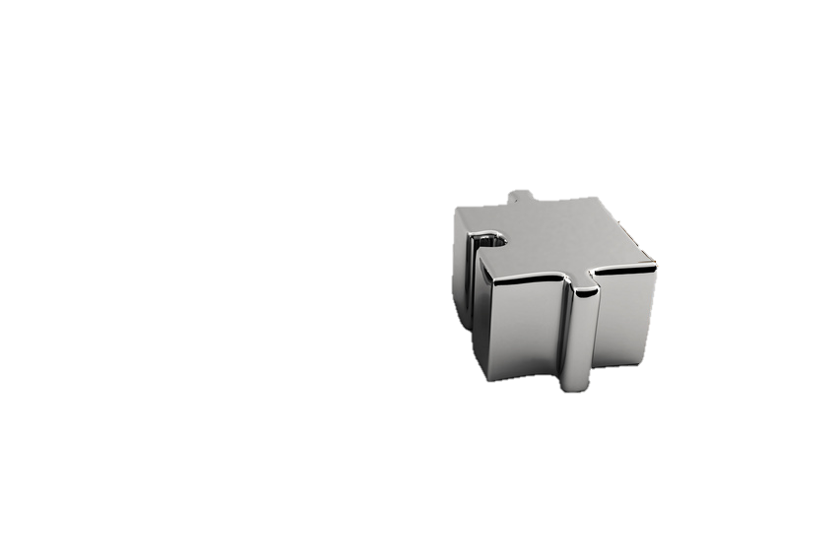
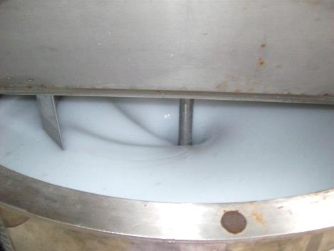
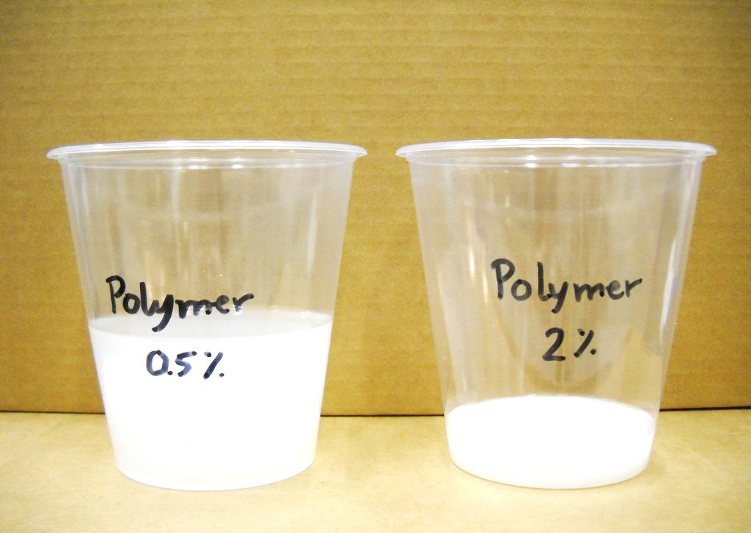
Preparation of Nalco Flocculants
Flocculants
Concentrated, homogeneous flocculant solution actively binds solid particles in sludge with small volume of dilution water
  Up to 2 % versus 0.2-0.5 % normal
Short aging time allows fast response to changing sludge flow and quality
  Saves up to 90 % polymer dilution water

Slide 10
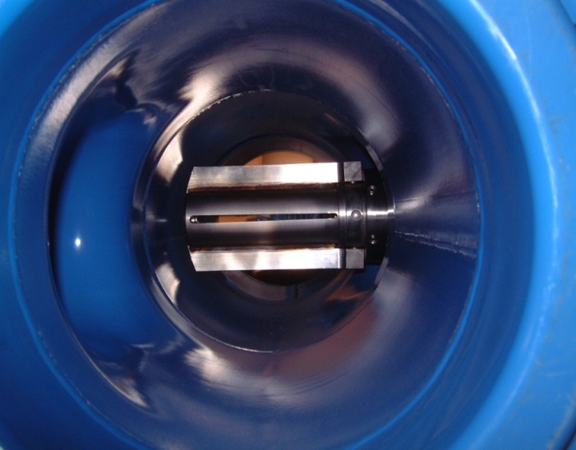
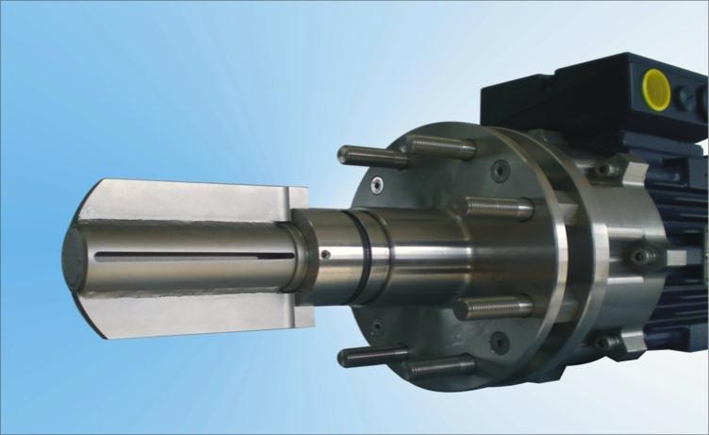
FLOCMASTER™ technology
FLOCMASTER
technology
Patented heart of the technology
Good distribution and intimate mixing of concentrated polymer in sludge of polymer will achieve optimum dewatering, high dry cake solids and good filtrate / centrate quality
  Up to 5 % higher cake dry solids
  Can treat high concentrated sludge (up to 20%)
  Better quality of centrate / filtrate
  Improved hydraulic load of dewatering device

Slide 11
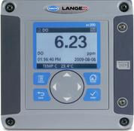
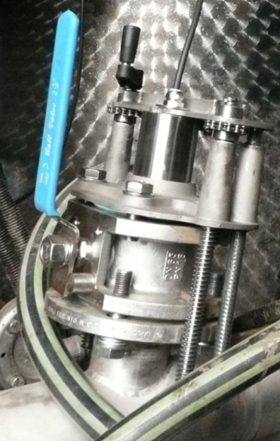
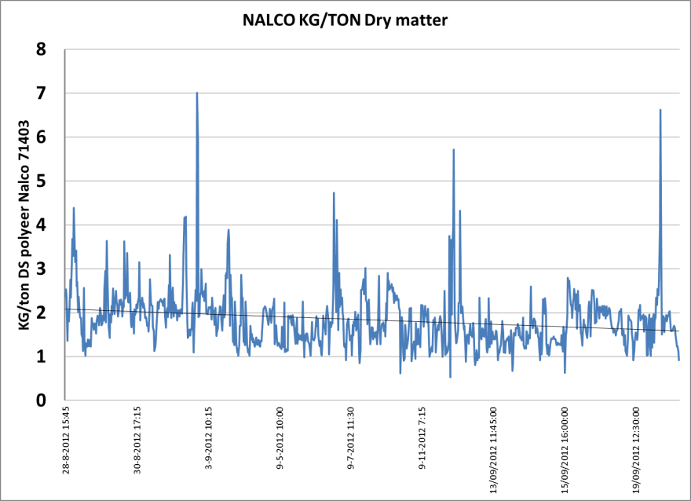
FLOCMASTER Automation
Automation
On-line signal will allow control of polymer feed pump to respond to changes in flow or concentration of sludge
  Optimal Flocculant dosage based on solids load instead of flow
  Up to 25 % reduction of Flocculant consumption
  Stable dewatering results
  Less operator time

Slide 12
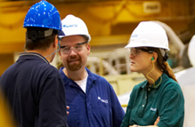
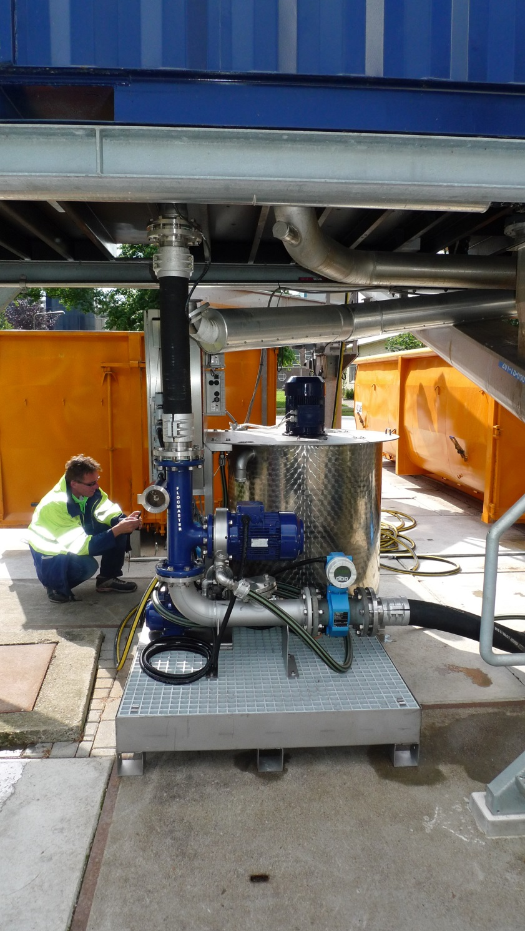
Personal service
Service
Trained, dedicated WE Team, dedicated to wastewater innovations like FLOCMASTER
Trained Customer Project Engineers and service engineers to implement FLOCMASTER innovation
Analytical resources for wastewater per region
Best practices and training material globally used

Slide 13

Understanding Our Solutions
Nalco FLOCMASTER Technology is a unique, innovative package designed for sludge dewatering applications to deliver quantifiable sustainability performance and operational efficiency.
This patented dynamic mixing technology in combination with world-class flocculants continuously responds to changes in sludge quantity.
The result is:
  Improved hydraulic load of the dewatering equipment
  Increased cake solids by 2-5%
  Reduction of make-down water by 50-90 %
  Reduction of consumable products by 10-20 % .
Notes:
{Instruction: this is Nalco innovation – solution slide 1}

Slide 14
Understanding Our Solutions: Nalco’s Programme for sludge dewatering
Integrated Dewatering Program
Best-in-class chemical programmes to help our industrial partners reduce energy, water usage and minimize environmental impact while boosting the bottom line
FLOCMASTER Technology to ensure good distribution and intimate mixing of chemicals with sludge flows for optimal performance
> 22,000 employees on-site with our customers every day in 170 countries, all supported by a team of experts

Slide 15
Generating Value
FLOCMASTER Technology for sludge dewatering

Slide 16




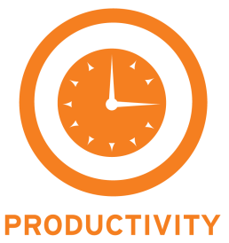
Environmental Indicators eROI Economic Results
FLOCMASTER CASE HISTORY
CUSTOMER: Paper Mill in Southern Europe - APPLICATION: Screw Press
BUSINESS DRIVER
Increasing solids dryness from 53% to 56% reduced sludge volume by 5000 ton plus 70 ton polymer from optimized dosing
CURRENT STATUS
Reduction in sludge management costs by €272.000 per year
BUSINESS DRIVER
Lower water content in sludge for on-site incineration reduced fuel gas demand by over 330.000m3 per year
CURRENT STATUS
Greenhouse gas emission reduced by 668.000 tonnes of CO2; savings of €122.000 in Energy cost
BUSINESS DRIVER
Specific fresh water consumption
down by 64680m3 per year
CURRENT STATUS
Lower fresh water demand has reduced water costs by over €1000 per year
BUSINESS DRIVER
Efficiency of the Wastewater operation
CURRENT STATUS
Due to lower hydraulic loading, better runnability
Total TCO savings : €395,000 per year

Slide 17
Environmental Indicators eROI Economic Results
FLOCMASTER CASE HISTORY
CUSTOMER: Soil Cleaning plant in Northern Europe - APPLICATION: Belt Press
BUSINESS DRIVER
Reducing annual sludge volume by 2600 Tonnes
Improvements in the efficiency of the treatment and application reduced the volume of consumables by 18% per year
CURRENT STATUS
Sludge volume reduction led to lower disposal and transportation costs by €78,000 per year
Reduction in the annual cost of treatment consumables of €30,000 per year
BUSINESS DRIVER
Fresh water consumption used in polymer preparation reduced by 60%
CURRENT STATUS
Reduction in water costs of over €6,200 per year
BUSINESS DRIVER
Improve productivity
CURRENT STATUS
Customer was able to operate only one of its two belt presses leading to lower maintenance and operating costs
Total TCO savings :
€114,000 per year

Slide 18
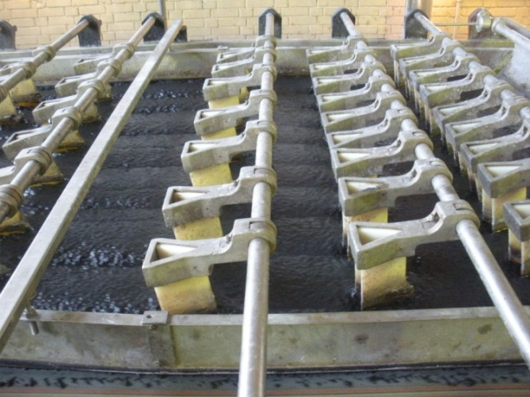
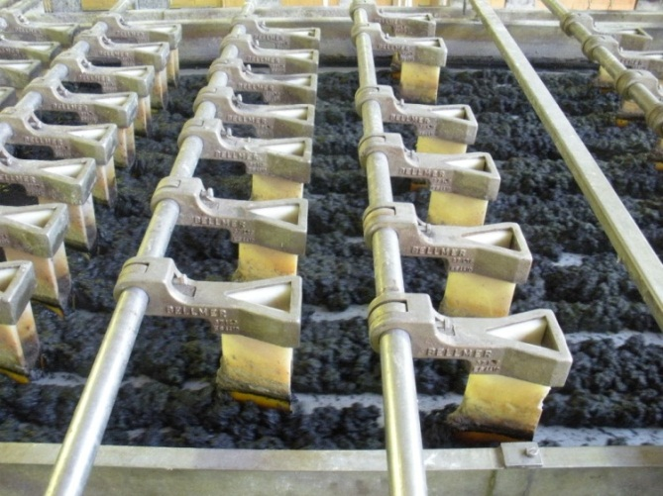
FLOCMASTER CASE HISTORY
CUSTOMER: Paper Mill in Central Europe
APPLICATION: Belt Press (x2)
eROI Economic and Environmental Results
64% less fresh water used in polymer preparation
6% lower sludge volume production
6% lower polymer consumption
Increased throughput to the belt presses
Total TCO savings :
€250,000 per year
Before
After

Slide 19
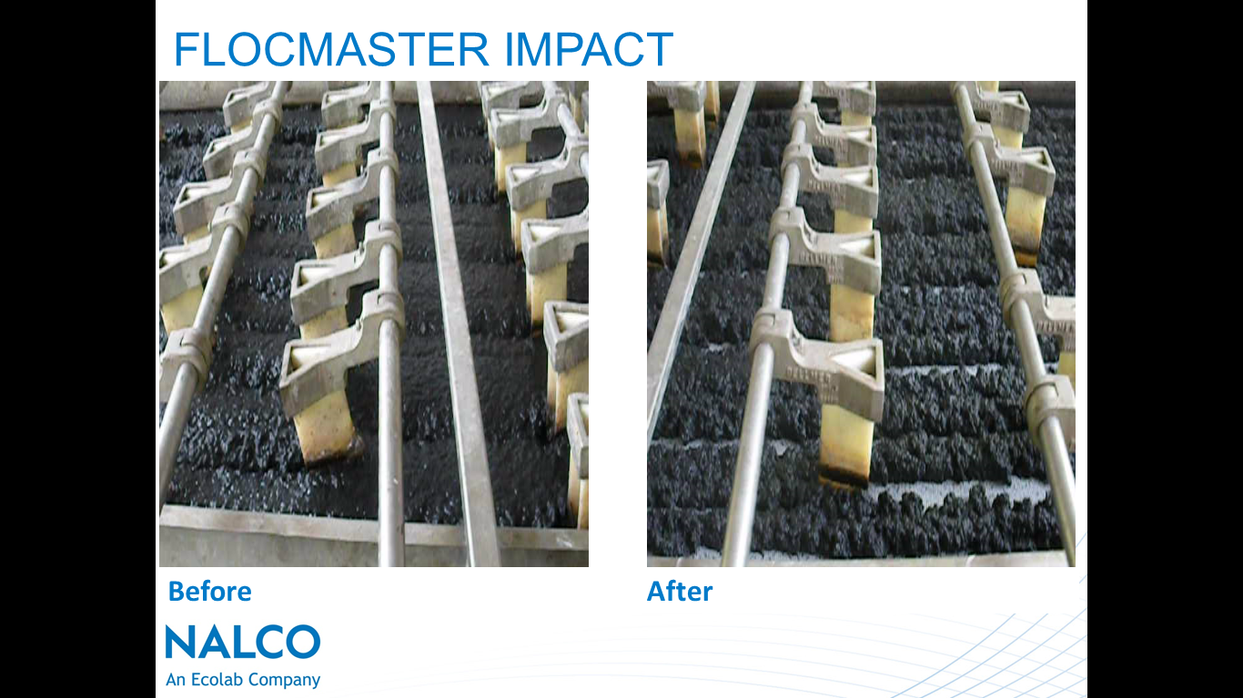
FLOCMASTER IMPACT
Before
After

Slide 20
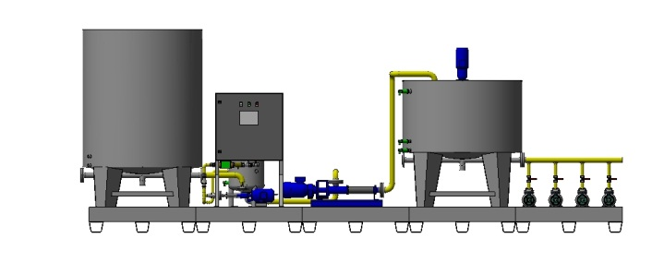
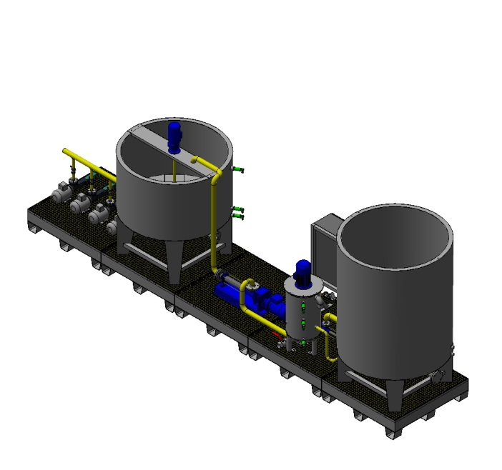
FLOCMASTER CASE HISTORY
CUSTOMER: Food Plant in Central Europe - APPLICATION: Centrifuge
eROI Economic and Environmental Results
85% Reduction in fresh water demand for polymer makeup lowering water costs by €4,200 per year
Reduction in consumables up to 20%
15% increase in sludge cake dryness, reducing off-site sludge disposal costs and also associated trucking operations and emissions by €32,000 per year.
FLOCMASTER Technology now implemented at 3 sites in Europe.
Total TCO savings (3 sites): €237,000 per year
Notes:
This slide shows the 3D engineering drawings for the solution implemented at one of the sites. Above actual and below the computer drawings. High engineering and technical solutions. Wastewater team that works towards designing and implementing solutions.

Slide 21
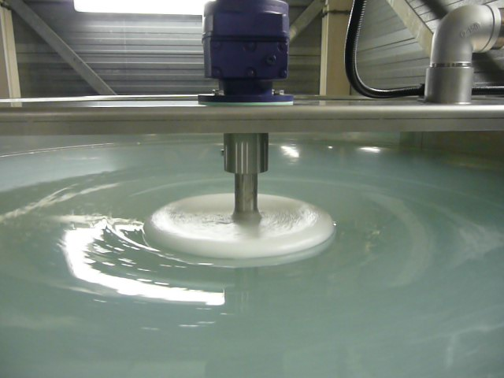
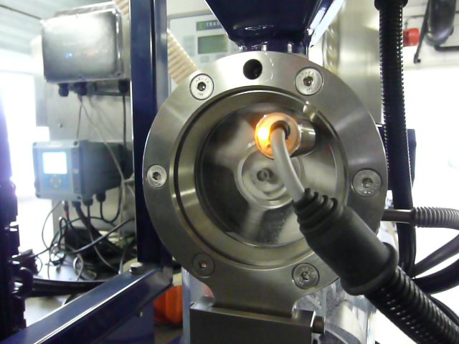
FLOCMASTER CASE HISTORY
CUSTOMER: Waste to Energy Power Plant, Central Europe - APPLICATION: Centrifuge
eROI Economic and Environmental Results
80% Reduction in fresh water demand for polymer makeup lowering fresh water costs by €6,000 per year
Reduction in consumables up to 27% lowering treatment costs by €60,000 per year
11% decrease in sludge volume produced, reducing off-site disposal costs and also associated trucking operations and emissions by €30,000 per year.
Total TCO savings :
€96,000 per year

Slide 22
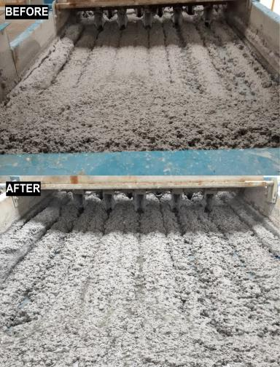
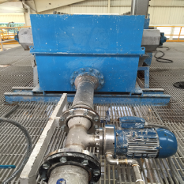
DELIVERING MEASURABLE RESULTS (ONGOING)
Improve dewatering capacity and reduce consumables
Plant: Paper Mill – Mexico – ongoing trial
Background: Sludge Dewatering Application
Situation:
  Capacity of dewatering system has been a bottle neck of production due poor sludge conditioning at GBTs. In the essence of water scarcity, a water conservation plan is in place to support investments at the WWTP.
Application: Nalco Flocmaster technology
e^{ROI}:
  Reduction in fresh water demand of about 30.000 m³ per year, -70% and flocculant by 20%.
  Increased production by 31%.
  Increased cake dryness in 2%.
Estimated Annual Savings:
  Water use reduction estimate delivering annual savings of USD 30.000. Further savings being consolidated with the customer, but we consider it will be significant!!!
The right solution for the problem.

Slide 23
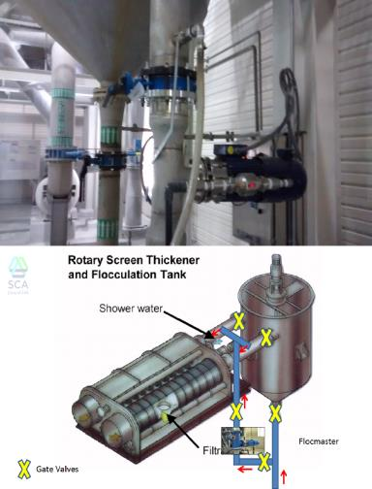
DELIVERING MEASURABLE RESULTS (ONGOING)
Reduction of operational cost and consumables
Plant: Tissue Mill – Mexico – ongoing trial
Background: Sludge Dewatering Application
Situation:
  It’s a new WWTP of this customer and expectation is to ensure stable process, reduced TCO and reduction and consumables. Overall water consumption per produced paper in ton is still considered high to date.
Application: Implementation of Flocmaster technology and high efficiency chemicals
e^{ROI}:
  Estimate annual reduction in fresh water demand of 45.000 m³ per year
  Increased efficiency of RST operation by 3% in cake solids
  Reduction of treatment consumables by 17 %
Estimated Annual Savings:
  We are consolidating estimates with the customer.
The right solution for the problem.

Slide 24
FLOCMASTER: Market Fit
Industries
Food & Beverage
Applications
Belt press
Screw presses
Different Sludges
Aerobic
Anaerobic
Pulp & Paper
Power
Mining
Centrifuges
Gravity tables
Manufacturing
Petrochemicals
Plate & Frame presses
Mineral
Mixed anaerobic-aerobic
Primary& Secondary Mixtures
Sludge Thickening

Slide 25

Summary
Delivering superior sustainability performance and TCO reduction
  Contributes to environmental sustainability by saving water, reduction of solids disposal
  Provides consistent asset reliability and availability by improved hydraulic load of the dewatering equipment
  Improvement of treatment and application efficiency
Average industrial results
  Increased sludge dry solids by 1-5%
  Reduction of make-down water by 50-90 %
  Reduction of chemical usage by 15-25 %
  Improved hydraulic load of the dewatering equipment
Notes:
{Read summary slide}

Slide 26
Questions ???
NALCO’s Programme for sludge dewatering?
FLOCMASTER Technology?
Nalco’s chemical programmes for wastewater?
Nalco’s on-site expertise?
Our case studies?
PRODUCTIVITY

Slide 27

PRODUCTIVITY

