Slide 1
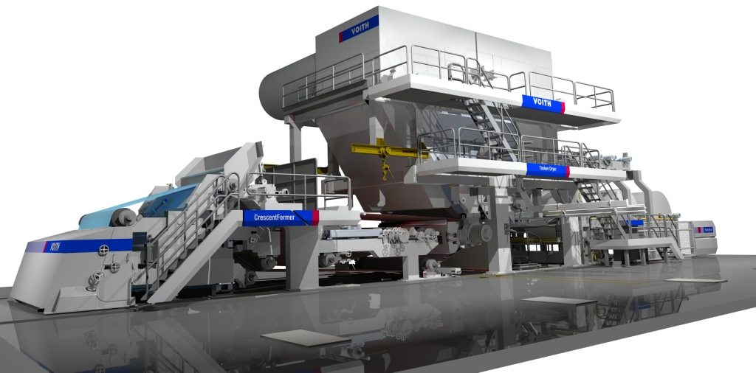
Voith VTM 1
NipcoFlex T – Shoe Press

Slide 2
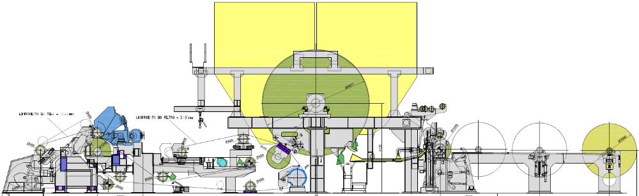
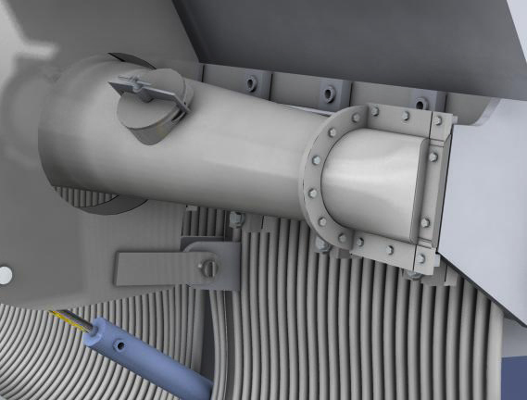
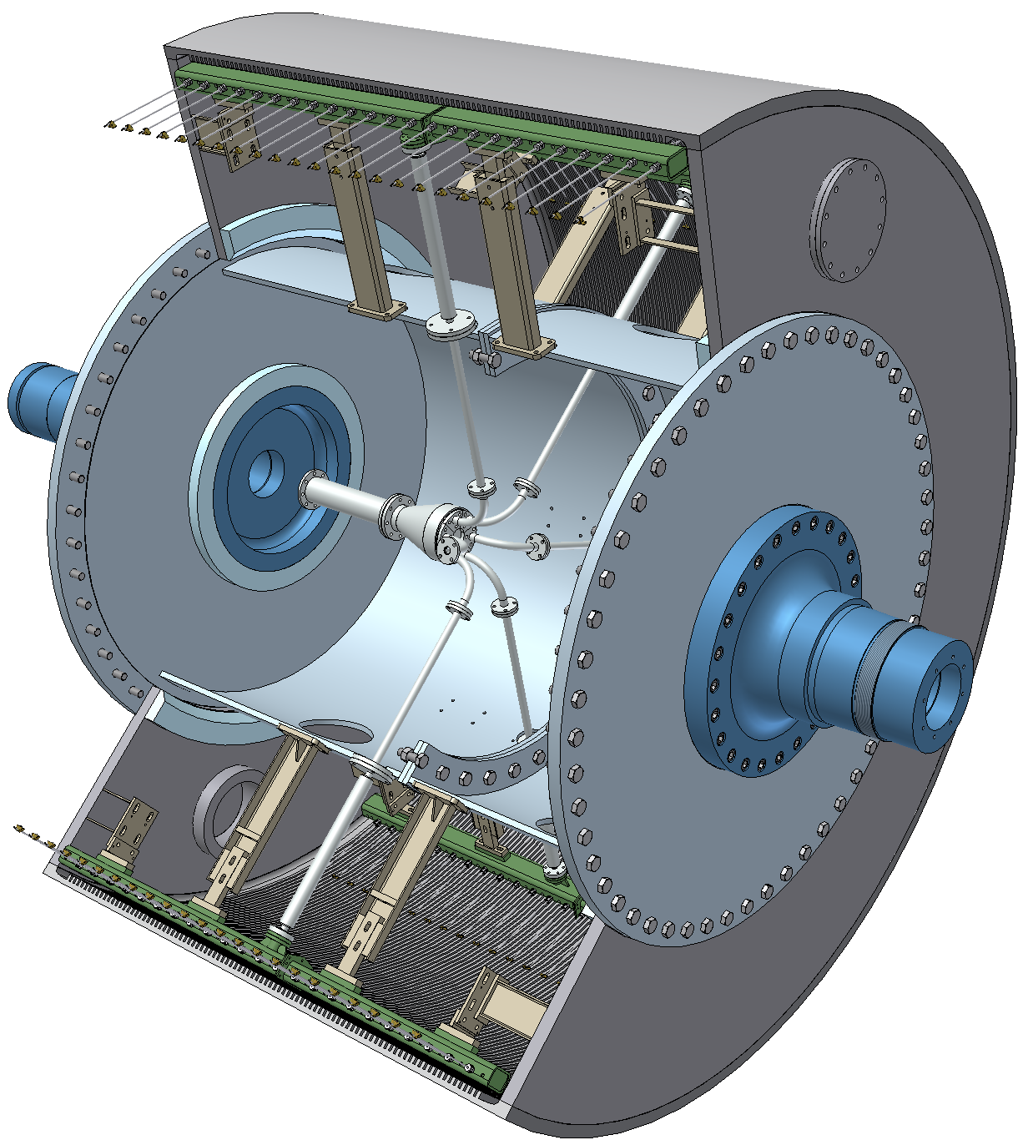
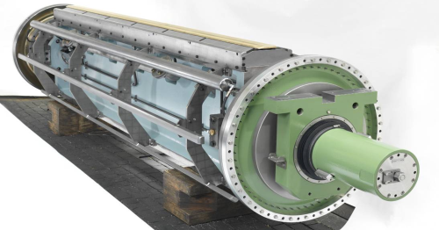
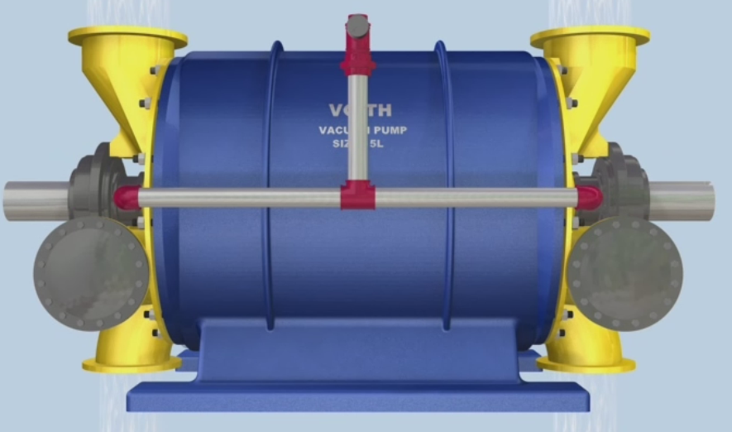
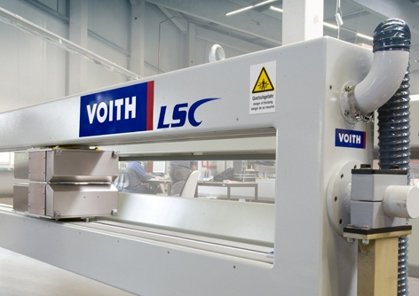
Voith VTM 1
MasterJet Pro T
Headbox without recirculation
EvoDry Y Steel Yankee Dryer
NipcoFlex T
Shoe Press
Vacuum Pumps
LSC Scanner

Slide 3

NipcoFlex T Shoe Press

Slide 4

NipcoFlex T Shoe Press

Slide 5
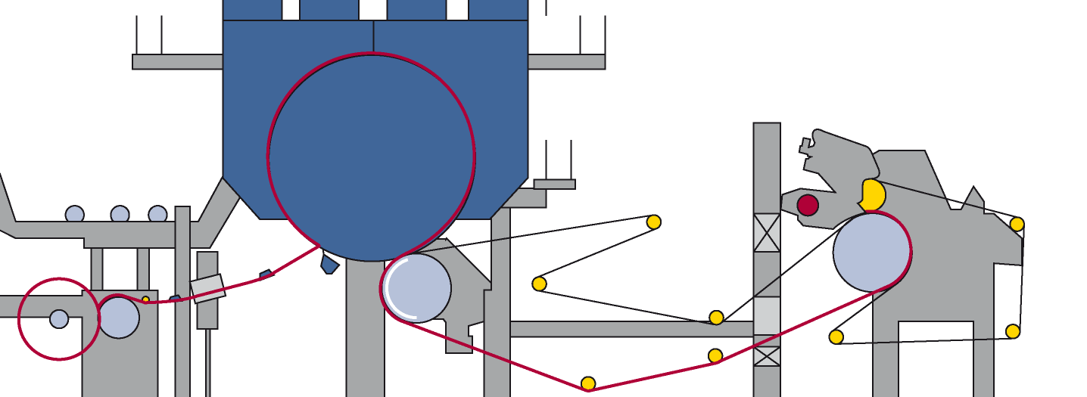
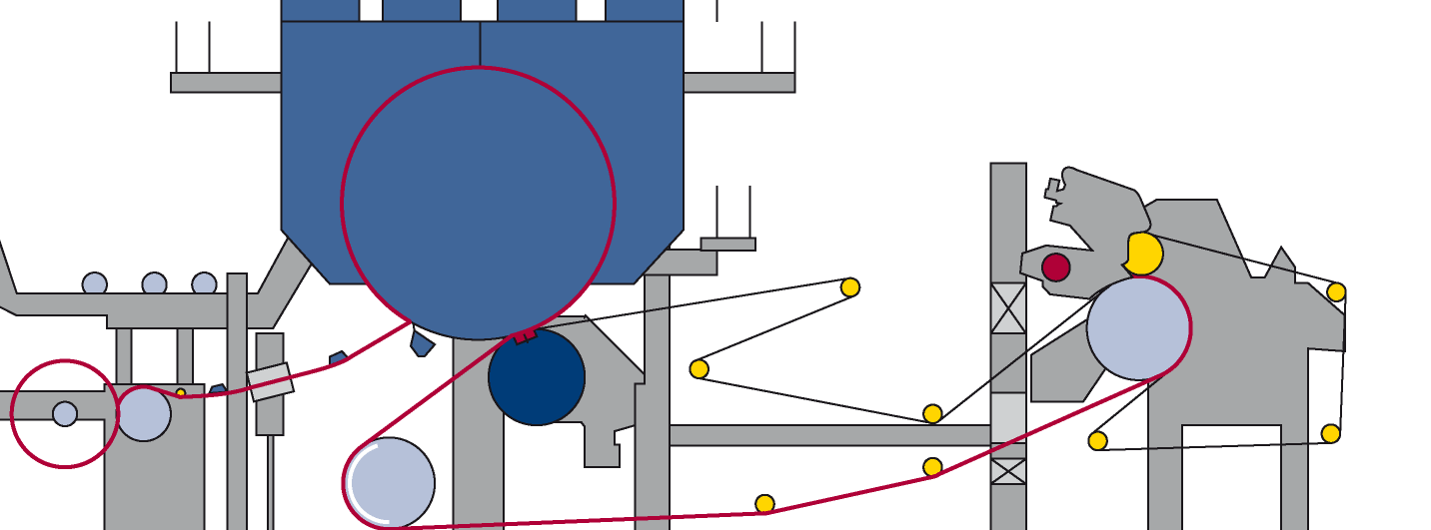
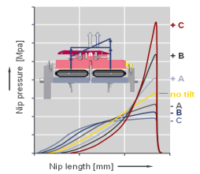
NipcoFlex T Shoe Press
Principles
0.2%
Suction Press Roll
95%
40%
12%
10%
0.2%
Voith NipcoFlex T
95%
44%
23%
10%
12%

Slide 6
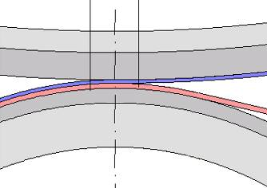
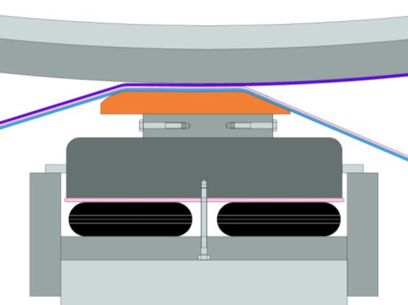
NipcoFlex T Shoe Press
Pressure profile
Suction Pressure Roll
NipcoFlex T
L
2 L
Increased press nip length
Fast pressure drop at nip outlet – less rewetting

Slide 7
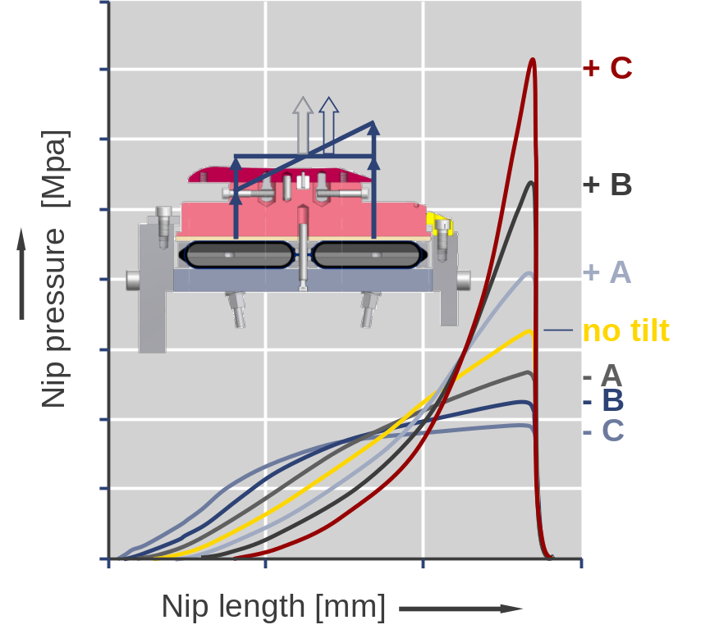
NipcoFlex T Shoe Press
What makes NF-T technology unique?
Quick drop after peak pressure to avoid rewetting = high dryness
(special grinded Aluminum alloy shoe)
no bulk degradation, due to narrow peak pressure
bulk generation, low peak pressure with same linear load

Slide 8
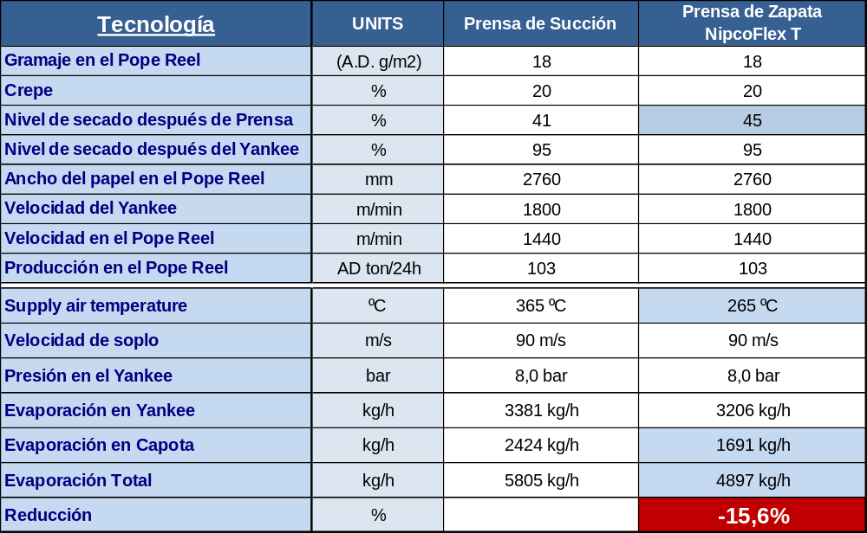
NipcoFlex T Shoe Press
Energy Savings

Slide 9
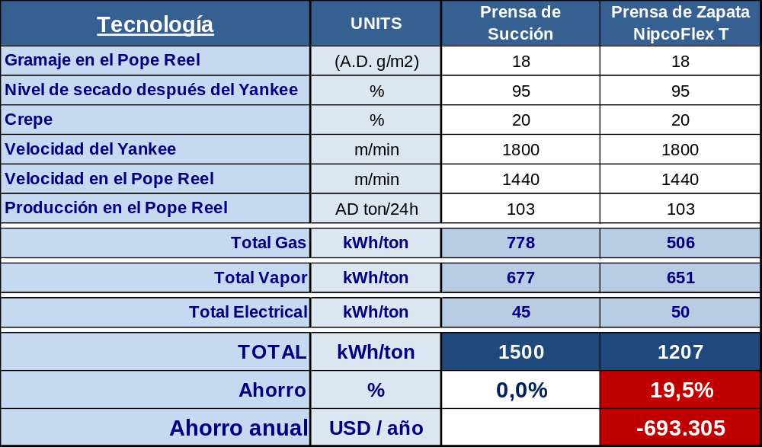
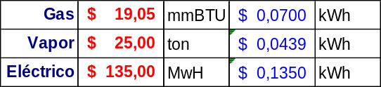
NipcoFlex T Shoe Press
Energy Savings

Slide 10
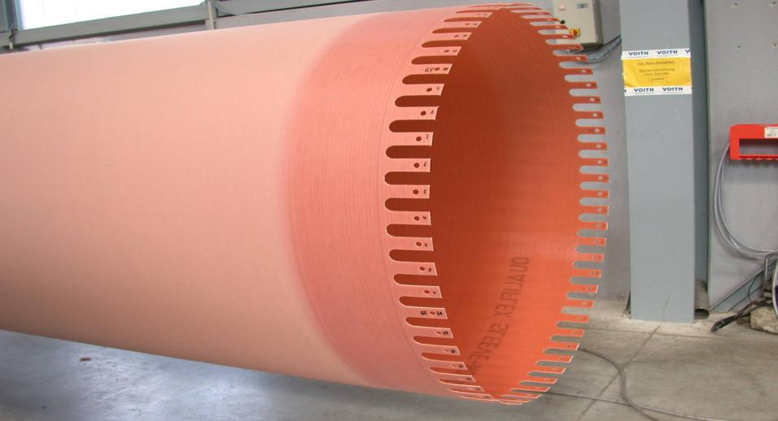
NipcoFlex T Shoe Press
Sleeve

Slide 11
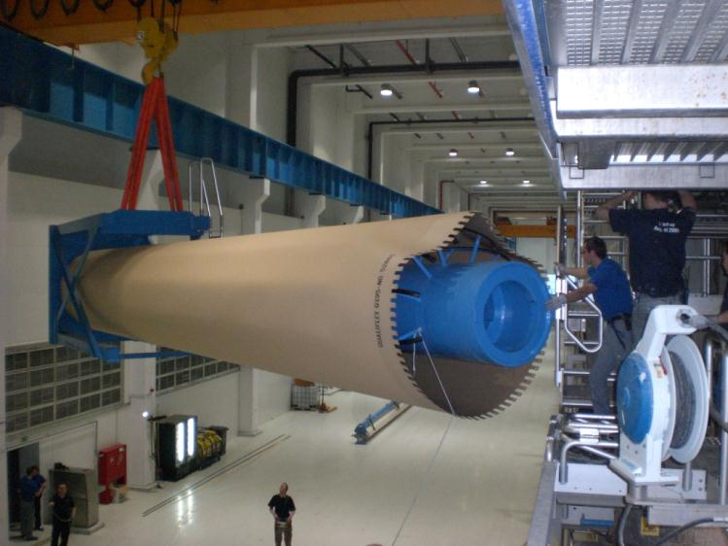
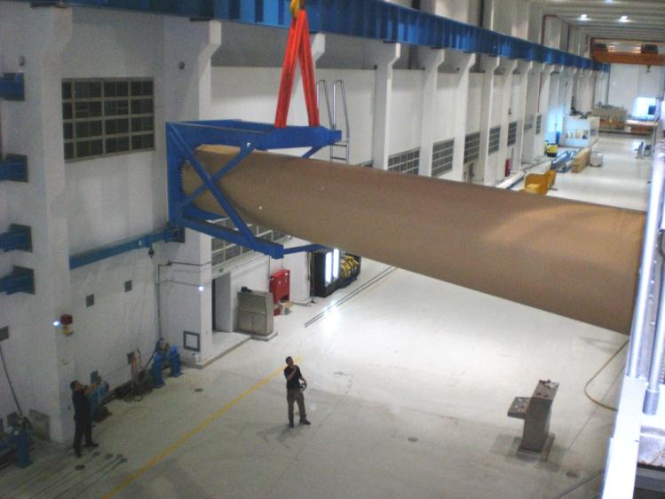
NipcoFlex T Shoe Press
Sleeve changing device

Slide 12
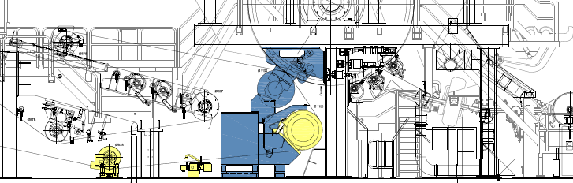
NipcoFlex T Shoe Press
Machine Rebuild

Slide 13
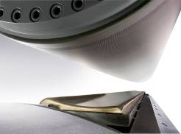
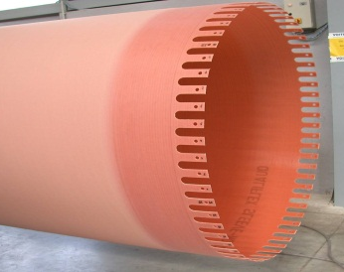

NipcoFlex T Shoe Press
Machine Rebuild
Flexible shoe = better CD profile
Suction Turning roll => no need for rubber cover, grinding = no transportation
Sleeve Life 5 – 8 months
Up to 5% higher dryness
Cost Savings up to USD 1.5 Mio/year for 5.4m Machines
Nip Length

Slide 14
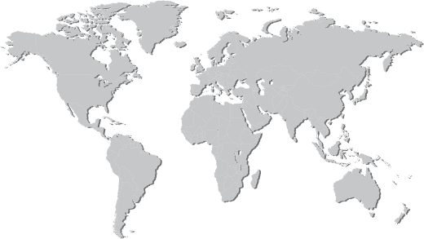
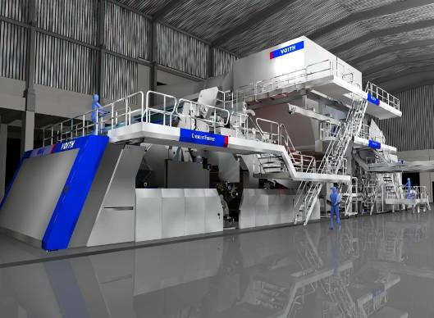
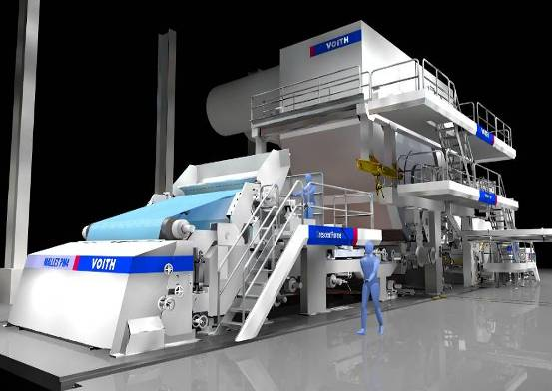
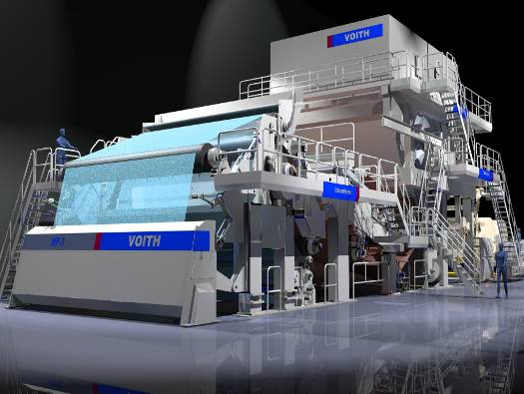
NipcoFlex T Shoe Press
Last References (since 2010)
SCA
1 Rebuild
3.6 x 2000 m/min
2013 - Mexico
NTG
1 Rebuild
3.4 x 1600 m/min
2010 - Great Britain
Miltenberg
1 x TM
2.8m x 2000 m/min
2013 - Germany
Metsäe Tissue
2 x TMs
2.8m x 2000 m/min
2011 - Poland
KleanNara
1 x TMs
2.95m x 2000 m/min
2013 - South Korea
Mili
1 x TM: 5.6m x 2000 m/min
2 x Rebuilds: (Mili 4 & 6) 2.8 m x 1600 m/min
2011 - Brazil
Yinge
2 x TMs
5.55m x 1900 m/min
2011 - China
Sepac
1 TM
2.8 x 2000 m/min
2012 - Brazil
Confidential
2 x TMs
5.6m x 2000 m/min
2012 - China
KC
1 Rebuild
2.8 x 1800 m/min
2014 - Peru
Captain Bermudez
1 TM
2.8 x 1800 m/min
2012 - Argentina
ChengLoong
1 TM
3.7m x 2000 m/min
2014 - Taiwan
Sun Paper
1 TM
2.8m x 1800 m/min
2011 - Indonesia
Lee&Man
1 x TMs
5.6m x 2000 m/min
2013 - China

Slide 15

Contact:
Sérgio Vargas
P&S Tissue – Regional Sales Manager
Voith Paper São Paulo
Tel. +55 11 3944 5171
Cel. +55 11 98566 0942
sergio.vargas@voith.com

Slide 16


